Slide 1
Extracting Causal Relations from Electronics & Supply Chain News
Fiona Anting Tan Institute of Data Science National University of Singapore, Singapore tan.f@u.nus.edu
23rd Feb 2023
Notes:
To extract the hidden pattern in data to understand the interrelation between factors—in future to establish causality

Slide 2
NLP Tools
METHODOLOGY
POS / Dependency Parsing with Stanza
Causal Sentence Classification with UniCausal
Cause-Effect Span Detection with UniCausal
Frames Parsing with OpenSESAME
Cause-Effect Argument Detection with adapted CauseNet
Cause-Effect-Signal Span Detection with 1Cademy
Causal Pair Classification with UniCausal
Notes:
#4 skipped cause too slow
#6-7 are viable to deploy, but will need 1-2 weeks to adjust to new data

Slide 3
Outline
METHODOLOGY
Extract NLP information using tools
Clean up UniCausal Causal Examples
Link up same arguments that are sequential in text (`join_neighbouring_args`)
Clean up CauseNet Causal Examples
Link up relations in same sentence, with same causal pattern, and one same argument (`combine_causenet_args`)
Treat spans as words between root word and signal
Align UniCausal and CauseNet Causal Examples
Grouping and Stemming Arguments
Notes:
Main addition: For CauseNet, we take all words around the Signal up to/from the Cause/Effect word.

Slide 4
Issues for Discussion
FINDINGS
Duplicate data ✓
Long sentences/paragraphs ✓
Causal relations curation rules ✓
Strategy to group nodes !!
Multiple causal relations per sentence x

Slide 5
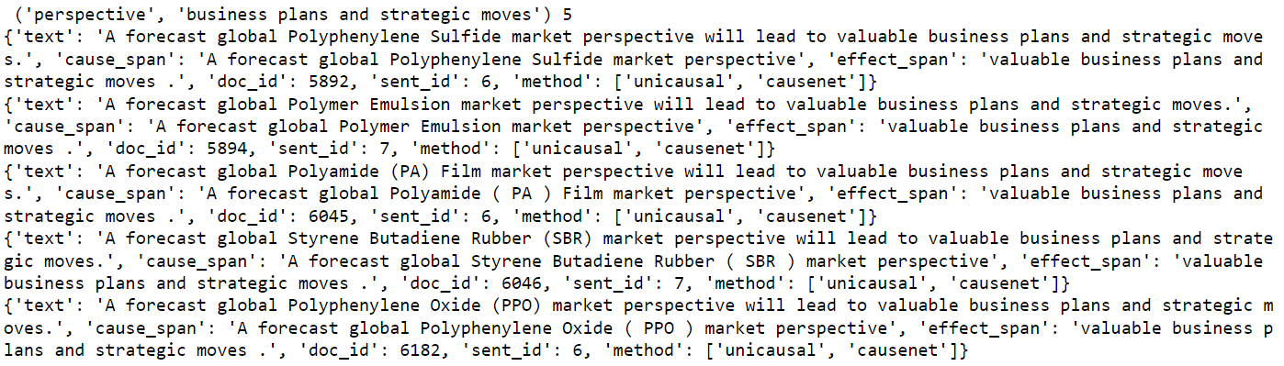
Duplicate Data
FINDINGS
Problem: Even after deduplication, there are articles that are very similar, which we did not remove
Solution: Removed exact duplicates (ignoring spaces), keep very similar entries for further processing
Notes:
Should I remove exactly same sentences (from different articles)? Or ignore/act as if they don’t exist (small sample size anyway)
→ verdict: Maybe repeated entries <1 support, e.g. this example gets like 1.5 support or smth

Slide 6
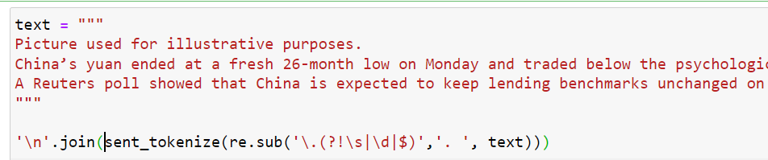
Long Sentences/Paragraphs
FINDINGS
Problem: Sentence tokenizer doesn’t work for examples with poor spacing
Solution: Added whitespaces after periods (.) that have trailing words right after it
Outcome: 55354 → 62151 sentences*
*automatically split
Notes:
Main impact:
Extraction not possible for information presented at the back of sequences
Should we re-tokenize and re-run the code?

Slide 7
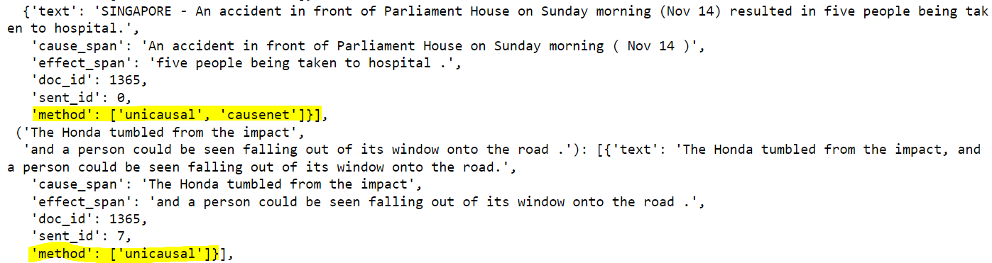
Causal relations curation rules
FINDINGS
UniCausal: Only keep predictions with 1 predicted relation
CauseNet: Keep all predictions
Both: If both methods detects the same relation, support=2
Notes:
We wanted to add “levels” to the causal relations extracted

Slide 8
Data & Findings
FINDINGS
Original Data
6384 articles
Extracted Data
6613 relations from 6876 sentences
Cleaned Relations
___ relations
62,151 sentences
___ nodes
Simple visualization at: http://localhost:5006/mir
Notes:
Cleaned Relations depends on the next few slides first

Slide 9
Causal examples
Extracted Data
6613 relations
6876 sentences
Cause Span | Effect Span | Evidence
to get similar to the low cost available in China . | " A U . S . facility would need a better U . S . supply chain | "A U.S. facility would need a better U.S. supply chain to get similar to the low cost available in China."
they don ' t have the cash reserves | " The smaller borrowers , especially those in manufacturing are really suffering this time round | "The smaller borrowers, especially those in manufacturing are really suffering this time round, because they don't have the cash reserves," she said.
to produce good , low - cost , and high - performance batteries | " We are focusing on safety , long service life , and high - level quality | "We are focusing on safety, long service life, and high-level quality to produce good, low-cost, and high-performance batteries," Maeda said.
the chip crisis and the surge in Covid cases in some parts of the world . | ##Global car manufacturers like Toyota Motor Corp and Ford Motor Corp have decided to slash production sharply | Decoded | Impact of semiconductor chip shortage on global economyGlobal car manufacturers like Toyota Motor Corp and Ford Motor Corp have decided to slash production sharply in the wake of the chip crisis and the surge in Covid cases in some parts of the world.
Notes:
Some examples, the spans are all quite sound
Qn now is how to group the Spans == Nodes?

Slide 10
Strategy to group nodes
FINDINGS
Summary
Method |  | Statistics |  | Node Clustering
# | Name | # Rels | # Nodes | Supervision | Seman-tics | Node Format
1 | POS & NER Extraction | 5672 | 10619 | Unsupervised | No | [Object, Action]
2 | NER+Topic Modelling | 5943 | 3836 | Unsupervised | Yes | Top 3 words in topic
3 | Summarization/ Seq2Seq | 3984 | 4083 | Supervised | Yes | Open-ended generation
Notes:
Overview

Slide 11
Strategy to group nodes
FINDINGS
5672 relations
10619 nodes
Method 1: POS & NER Extraction
Steps:
Extract POS & NER information (Using NLTK & Stanford NER Tagger)
7-classes for NER: Location, Person, Organization, Date, Time, Money, Percent
Format each Cause/Effect span into an Events template
Cluster spans using [Object, Action] as topic
Object: Nouns =/= NER
Action: Verbs
Pros: Relatively simple to implement
Cons: (I) Sensitive to accuracy of NER parser, (II) Does not cluster semantically similar words (E.g. “cutback”, “cutbacks”, “reduction”), (III) Some nodes can be hard to interpret
https://nlp.stanford.edu/software/CRF-NER.shtml#Download
Notes:
http://localhost:8888/notebooks/79%20Mass/notebooks/Visualize%20Graphs_NER.ipynb
D:\66 CausalMap\SciLit_CausalMap\visualization\mir_ner

Slide 12
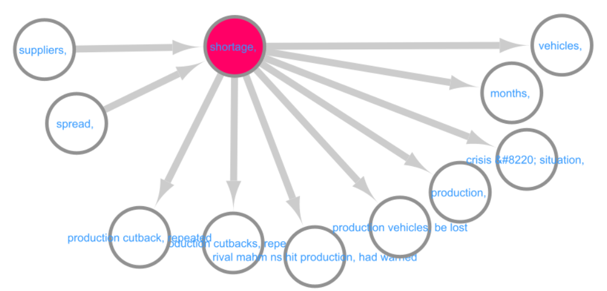
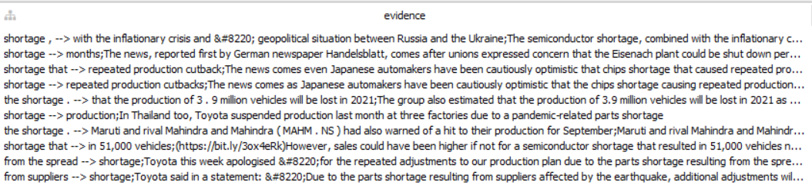
Strategy to group nodes
FINDINGS
Working example: Search “shortage” as root node
Method 1: POS & NER Extraction
Notes:
D:\66 CausalMap\SciLit_CausalMap\visualization\mir_ner
We visualize all graphs using the Cytoscape tool

Slide 13
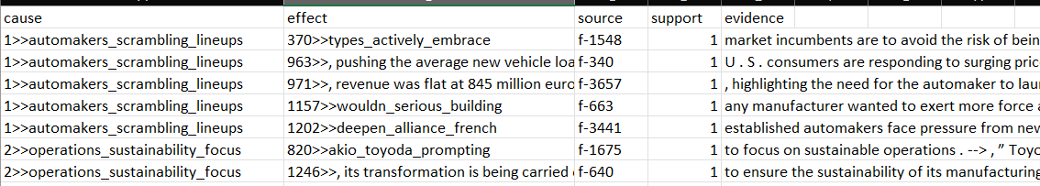
Strategy to group nodes
FINDINGS
5943 relations
3836 nodes
* Notice #rels>#nodes, graph is very “connected”
Method 2: NER+Topic Modelling
Steps:
Extract NER information to remove from span
Generate BERT-based word embeddings (Using SimCSE)
Optionally reduce feature dimension (Using UMAP)
Cluster spans (Using K-Means)
Use TF-IDF to find keywords per topic >> Or generate a title
Pros: Improves semantic clustering of nodes
Cons: (I) Nodes are a list of ‘common’ words, which might not be interpretable, (II) Unsupervised, hence unable to improve performance apart from tweaking some parameters
https://aclanthology.org/2022.naacl-main.285/
https://github.com/princeton-nlp/SimCSE
Notes:
http://localhost:8888/notebooks/79%20Mass/notebooks/NER%20Extraction%20for%20Nodes.ipynb
http://localhost:8888/notebooks/79%20Mass/notebooks/Visualize%20Graphs_NER.ipynb
D:\66 CausalMap\SciLit_CausalMap\visualization\mir_nerclust

Slide 14
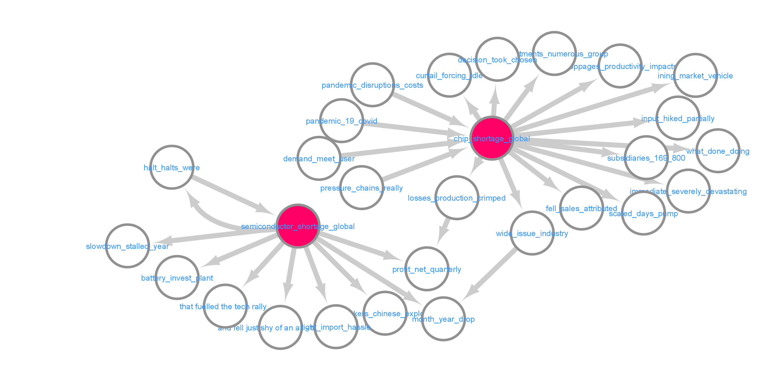
Strategy to group nodes
FINDINGS
Working example: Search “shortage” as root node
Method 2: NER+Topic Modelling
Notes:
D:\66 CausalMap\SciLit_CausalMap\visualization\mir_nerclust
Orange box = common effect, “shortage → in month year drop, in quarterly net profits”
Note: there are more nodes with the word “shortage”, just showing 2 here for easier discussion

Slide 15
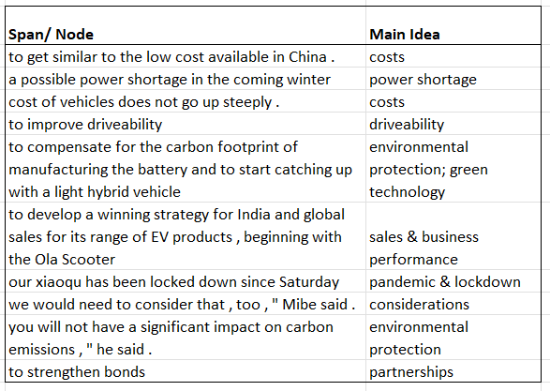
Strategy to group nodes
FINDINGS
3948 relations
4083 nodes
Method 3: Summarization/ Seq2Seq
Steps:
Annotate a small set of spans with topic(s)
Fine-tune Seq2Seq T5-small model to generate topics based on spans
Generate topics for all Cause/Effect spans
Pros: (I) Improves semantic clustering of nodes, (II) Supervised – learning and improvement is possible, esp. with more annotations, (III) Generated topics are more interpretable/ readable
Cons: (I) Requires some annotations, (II) Model can generate wrong topic predictions and can lead to completely wrong causal interpretations, (III) Depending on use case, topics can be considered “too general”
Notes:
http://localhost:8016/notebooks/79%20Mass/notebooks/Summarization%20for%20Nodes.ipynb >>> Run on Server
http://localhost:8888/notebooks/79%20Mass/notebooks/Visualize%20Graphs_Summarization.ipynb
D:\66 CausalMap\SciLit_CausalMap\visualization\mir_summ

Slide 16
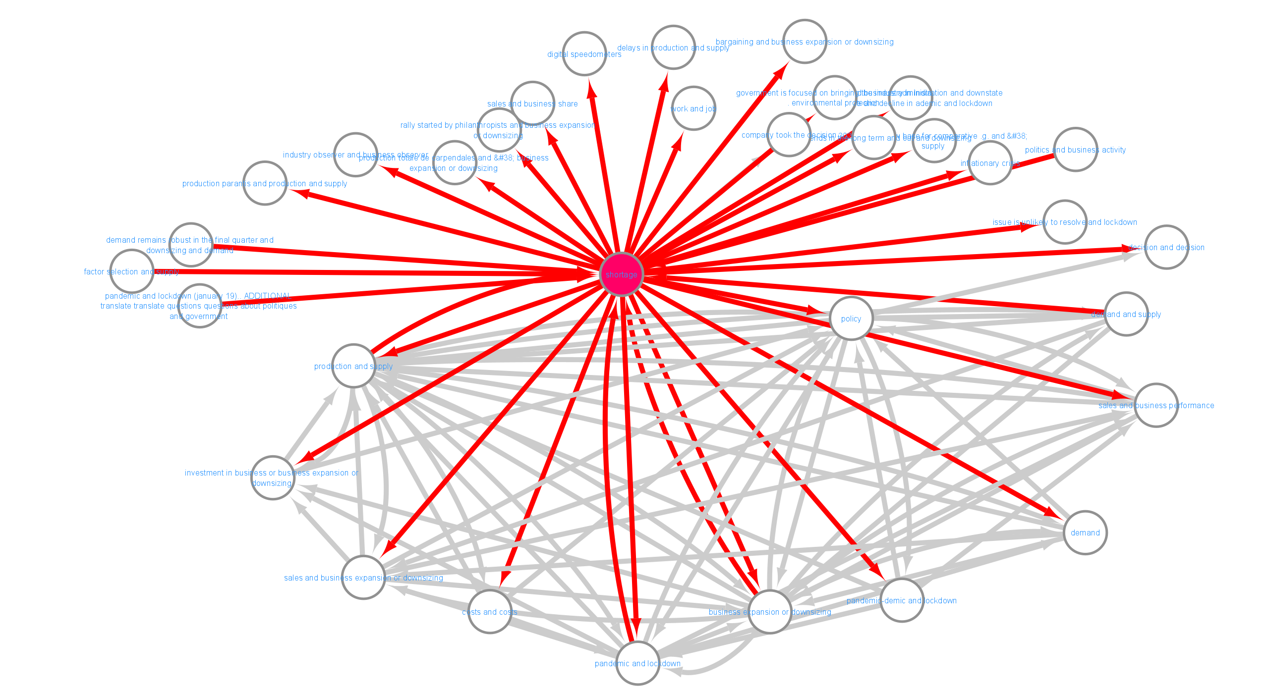
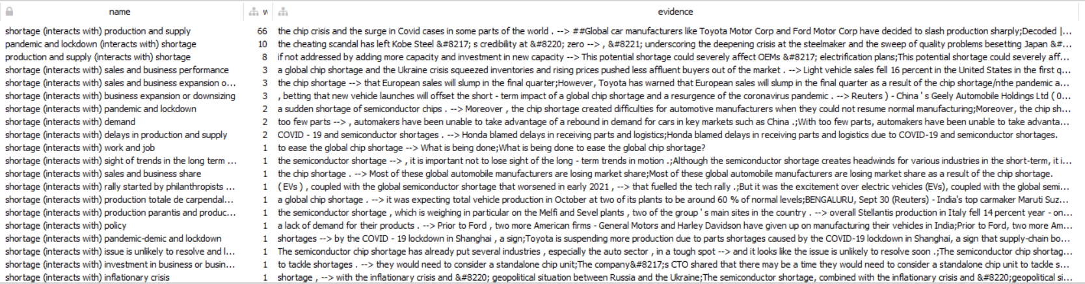
Strategy to group nodes
FINDINGS
Working example: Search “shortage” as root node
Method 3: Summarization/ Seq2Seq
Notes:
D:\66 CausalMap\SciLit_CausalMap\visualization\mir_nerclust
All connections to-from “shortage” node.
Top part → more details/unique
Bottom part → too general?

Slide 17
Strategy to group nodes
FINDINGS
Summary
Method |  | Statistics |  | Node Clustering
# | Name | # Rels | # Nodes | Supervision | Seman-tics | Node Format
1 | POS & NER Extraction | 5672 | 10619 | Unsupervised | No | [Object, Action]
2 | NER+Topic Modelling | 5943 | 3836 | Unsupervised | Yes | Top 3 words in topic
3 | Summarization/ Seq2Seq | 3984 | 4083 | Supervised | Yes | Open-ended text
Notes:
Overview

Slide 18
Multiple causal relations per sentence
FINDINGS
Problem: Current model cannot handle multiple relations in one sentence
Solution: Use
Notes:
Again, #6-7 are viable to deploy, but will need 1-2 weeks to study and adjust to new data
Many battery makers are ramping up production to meet soaring worldwide demand as car makers accelerate their shift to electric vehicles to comply with tougher emission rules aimed at tackling global warming .

Slide 19
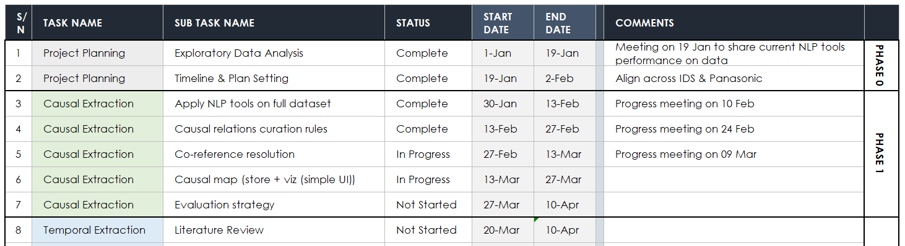
Timeline
Notes:
"D:\66 CausalMap\Panasonic_Electronic_KG\Panasonic_Timeline.xlsx"

Slide 20

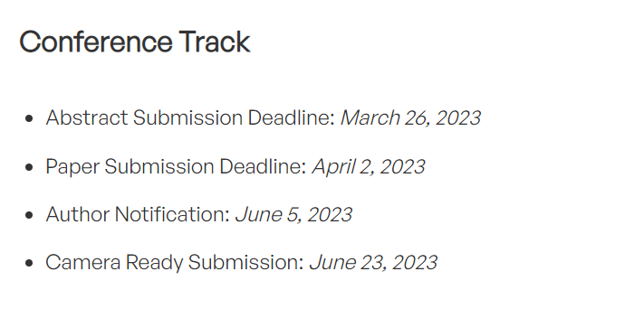
Research Contributions
SOTA CRE methods that extracts more causal relations: UniCausal extracts 5-6x more relations than just CauseNet template version alone
Span Co-reference Resolution: Unique/Tailored approach to group nodes that allows for (A) new topics to show, and (B) clustering by semantics
Industry application & feedback: Describe a good use-case, and some user-evaluation
https://2023.ecmlpkdd.org/submissions/key-dates-deadlines/
Notes:
Evaluation – For Extraction
Please annotate 10 articles (from one topic → E.g. shortage) with Cause & Effect spans
Evaluate 100 extracted causal relations’ sanity
Evaluation – For Clustering
From sample of 10 articles, identify clustering of spans. Compare “ideal” graph and ours.
Evaluation 100 nodes’
Evaluation – Use-case dependent
Use-case:
New article -> Extract events -> Identify possible effects (+Links to old articles)
End-of-month : Summarize NEW cause-effects, summarize TOP cause-effects

Slide 21
Evaluation
For Extraction
Annotate 10 articles (from one topic) with Cause-Effect spans
Evaluate 100 extracted causal relations’ sanity (Labels: Pass/Fail)
For Clustering
From the 10 articles, identify clustering of spans. Compare the ideal human-annotated graph vs. automatically extracted one.
Evaluate 100 nodes’ clustered spans’ sanity (Labels: Pass/Fail)
Use-Case Dependent
New article report: Extract events, identify possible effects (+Links to old articles)
End-of-month report: Summarize new/top cause-effects
Evaluate usefulness of each report
by 20 Mar?
Notes:
Can we aim to do these annotations by 20 Mar?

Slide 22
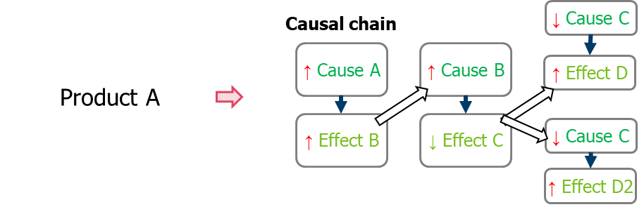
Discussion
Causal relations curation rules: All, add levels to the CE extracted
Prototype data size: Full dataset, or split by quarters
Evaluation strategy: TBD
Product identification
Temporal & sentiment aspect
Importance of other relation types
Cross-sentence relations
Source: Panasonic Industry
Notes:
Other details:
6384 unique articles, 55354 sentences in total to work with.
Should we prototype with all the articles or just a subset?
Are you sure causal relations are the only thing worth analysing? If the aim is to survey current trends and news, I think we need more than causal relations. It’s more of summary, highlight impactful sentences (maybe sentences with a lot of events), and maybe the causal part is a small point to note.
Multi-sentence issues
Issues after curating relations (can discuss later):
Synonyms/co-reference resolution/generalization issues

Slide 23
CONCLUSION

